Slide 1

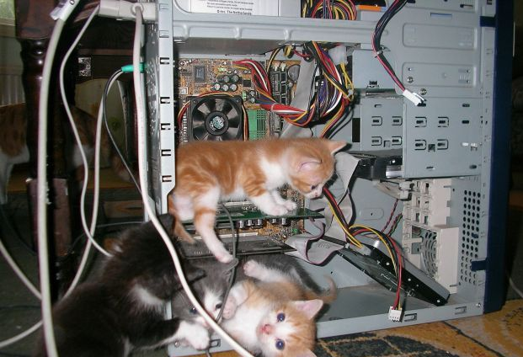
Introduction to Computer Science
Shimon Schocken
IDC Herzliya
Lecture 8-1
Computer Fundamentals
Part II
Notes:
1

Slide 2
Lecture plan
History of computer science
Before Alan Turing
After Alan Turing
High-level programming
Languages
Compilation

Slide 3
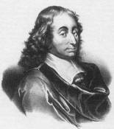
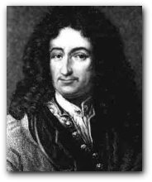

Early computers (17th century)
Blaise Pascal 1623-1662
Pascal’s Calculator
(Pascaline, 1652)
Add
Subtract

Slide 4

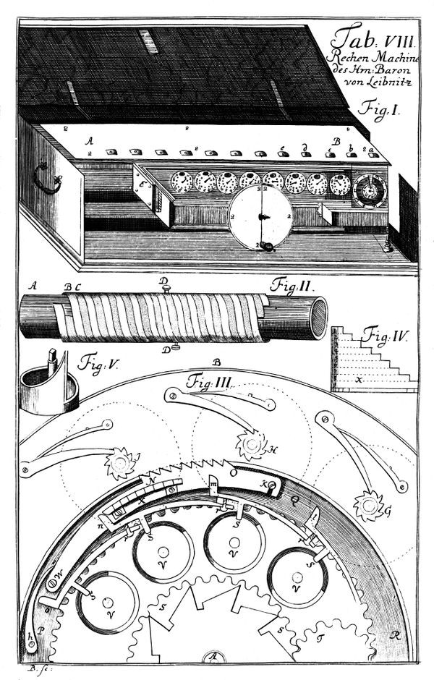
Early computers (17th century)
Gottfried Leibniz 1646-1716
Leibniz Calculator (1673)
Add
Subtract
Multiply
Divide.

Slide 5

Early computers (17th century)
Gottfried Leibniz 1646-1716
Leibniz Calculator (1673)
Add
Subtract
Multiply
Divide.
Side contributions: Advances in gears / mechanical engineering

Slide 6
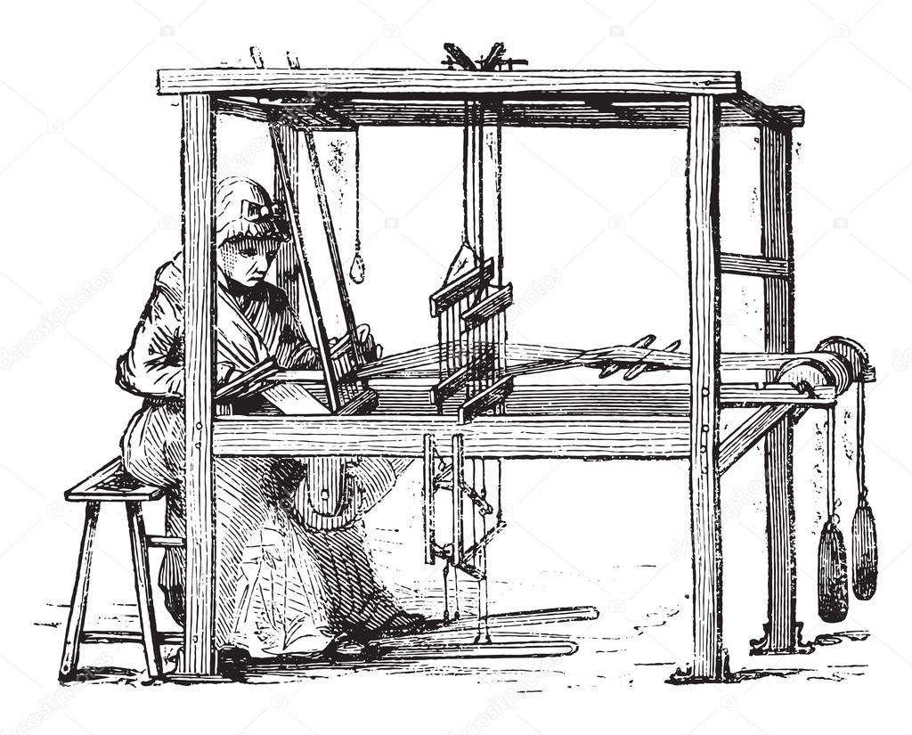
Early computers (19th century)
One of the most important inventions in the Industrial Revolution
Made clothing affordable
Made many human weavers unemployed
Led to the “Louddite” revolts
Jacquard Loom (1804)
After
Before

Slide 7
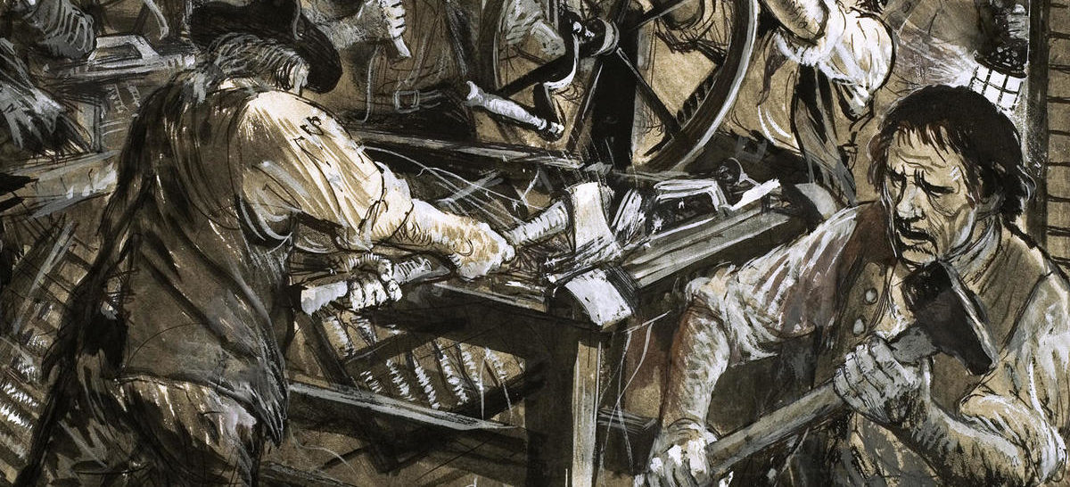
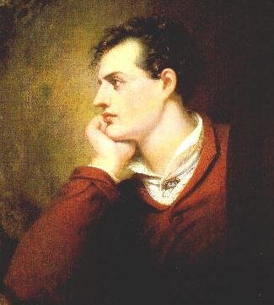
Early computers (19th century)
One of the most important inventions in the Industrial Revolution
Made clothing affordable
Made many human weavers unemployed
Led to the “Louddite” revolts
Jacquard Loom (1804)
Lord Byron (1878 – 1824)
One of the leaders of the Luddite Movement

Slide 8
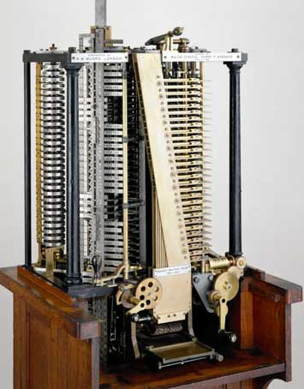
Early computers (19th century)
Jacquard Loom (1804)
Analytic Engine (1837)
An early British computer
Major innovation: Software!

Slide 9
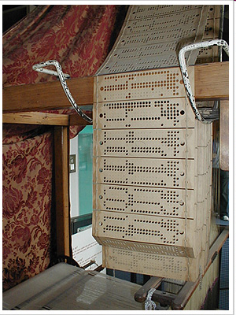
Early computers (19th century)
Jacquard Loom (1804)
Punched cards = instructions
Major innovation: Software!

Slide 10
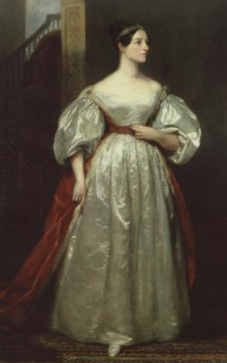
Software
Ada’s brilliant insight:
If you want to give a mechanical computer instructions, don’t start by punching cards (machine language)
Instead, use a (friendly) symbolic language for expressing instructions
Write and debug your program on paper, using this language
Only when convinced that the program is error-free, translate it into punched cards, and execute it.
Ada Lovelace (1815 – 1852)
Gifted mathematician and writer
Worked on an the “Analytic Engine”
Daughter of Lord Byron

Slide 11
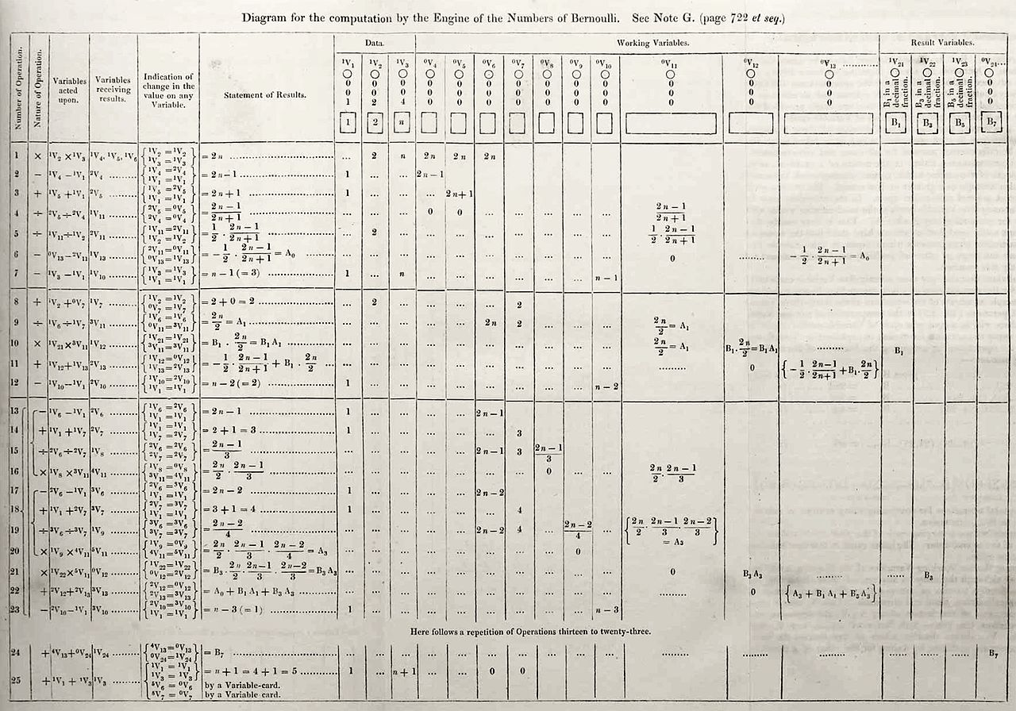

Software
First published computer program (Ada Lovelace, 1840):
Computes Bernoulli numbers on the Analytic Engine
Often described as “the first programmer”
The programming language Ada is named after her.

Slide 12
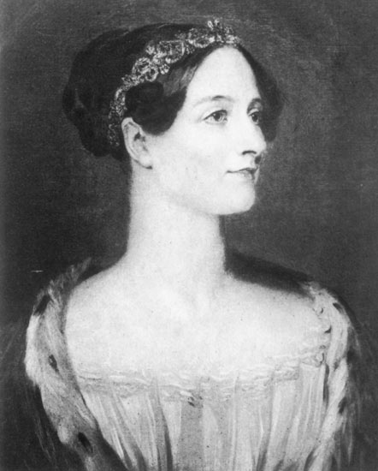
Ada Lovelace vision about the power and limitations of computers (1840!)
“The Analytical Engine might act upon other things besides number, were objects found whose mutual fundamental relations could be expressed by those of the abstract science of operations... Supposing, for instance, that the fundamental relations of pitched sounds in the science of harmony and of musical composition were susceptible of such expression and adaptations, the engine might compose elaborate and scientific pieces of music of any degree of complexity or extent.”
“The Analytical Engine has no pretensions whatever to originate anything. It can do whatever we know how to order it to perform. It can follow analysis; but it has no power of anticipating any analytical relations or truths.”

Slide 13

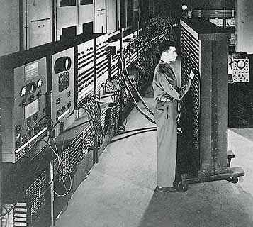
Modern computers (20th century)
John Von Neumann
ENIAC: First digital, programmable, stored program computer
University of Pennsylvania, 1946,
(Borrowed key ideas from other early computers and innovators)

Slide 14
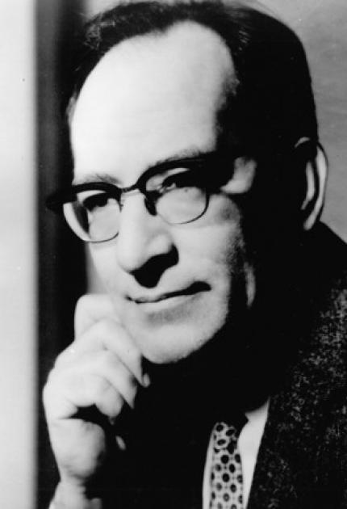
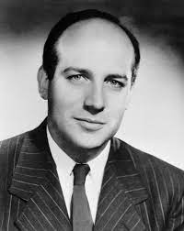
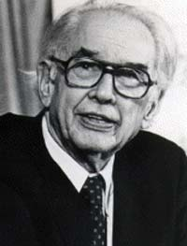
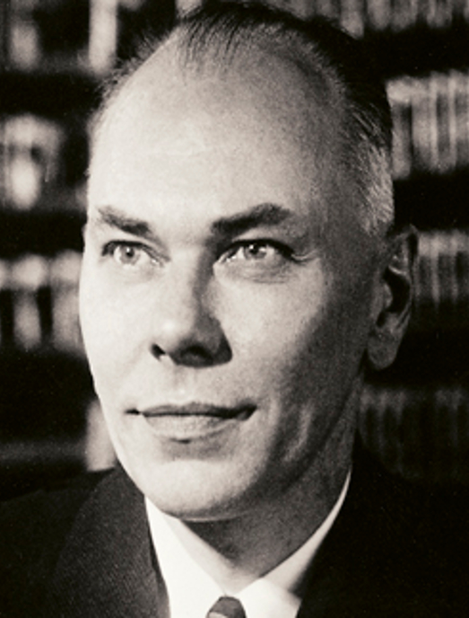
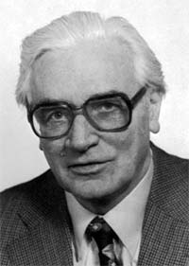
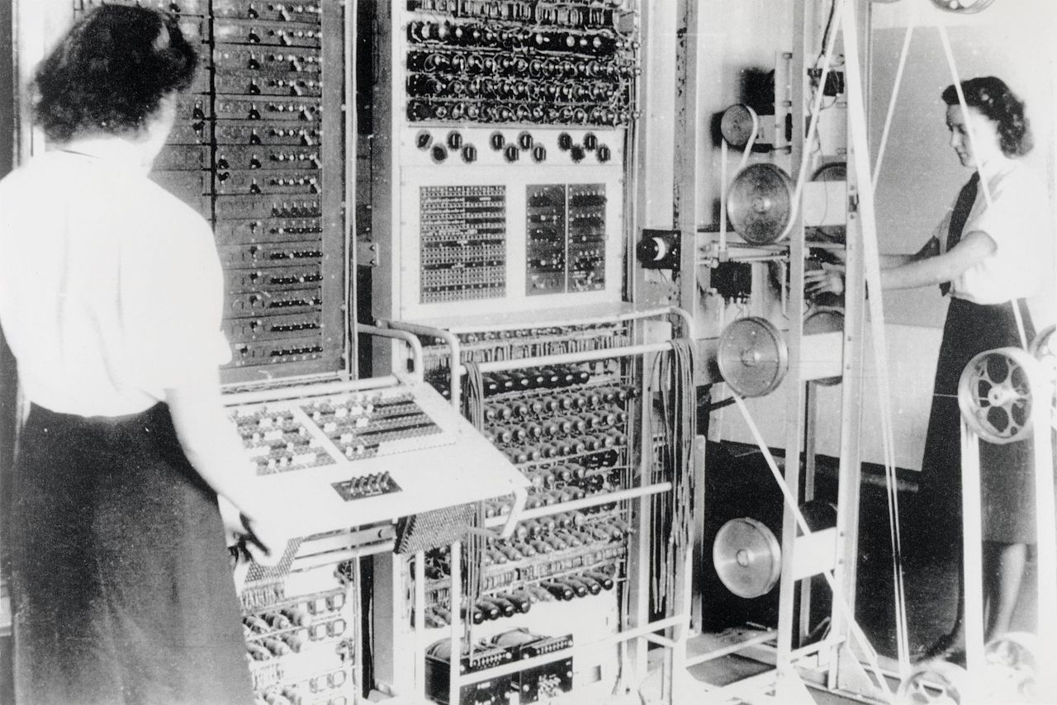
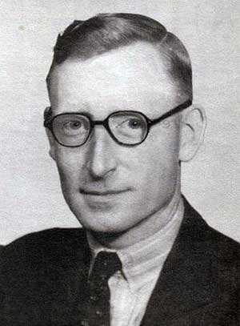
Modern computers (20th century)
John Mauchly
Presper Eckert
John Von Neumann
John Atanassof
Howard Aiken
Konrad Zuse
ENIAC: First digital, programmable, stored program computer
University of Pennsylvania, 1946,
(Borrowed key ideas from other early computers and innovators)
Tommy Flowers
Colossus: First digital, programmable, computer, UK, 1945

Slide 15
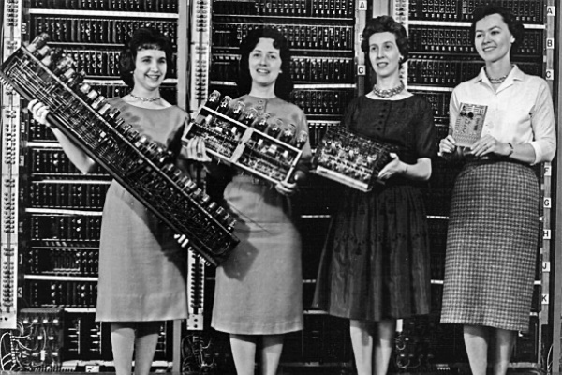
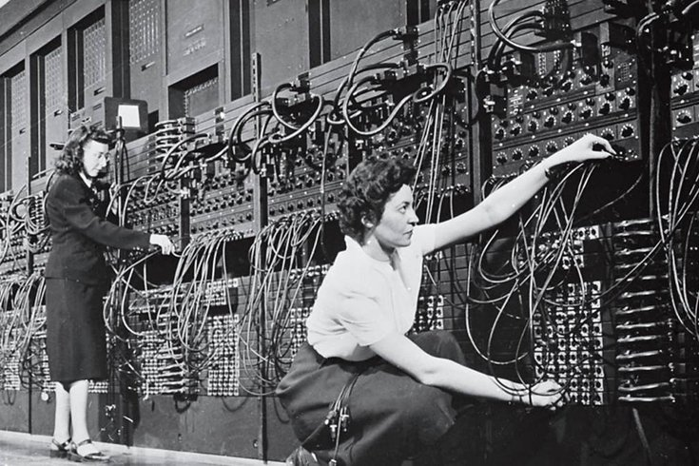
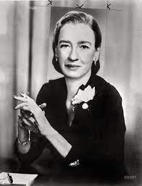
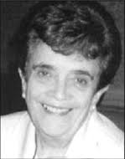
Modern computers (20th century)
ENIAC Women
Pioneered reusable code, subroutines, flowcharts, and many other programming innovations
Kathleen McNulty, Jean Jennings, Frances Snyder, Marlyn Wescoff, Frances Bilas, Ruth Lichterman
Compilation pioneers
(Mark I)
Grace Hopper
Adele Koss

Slide 16

Modern computers (20th century)
Same hardware can run many different programs (software)
Back in the 1950’s, this was considered a radical idea:
“If it should turn out that the basic logic of a machine designed for the numerical solution of differential equations coincides with the logic of a machine intended to make bills for department stores, I would regard this as the most amazing coincidence I have ever encountered” –– Howard Aiken, 1956 (Mark 1 computer architect)

Slide 17
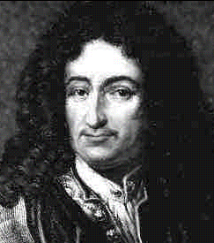
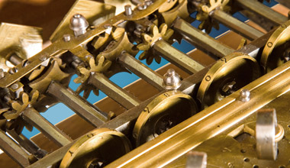
Leibnitz’s dream (1671)
Gottfried Leibniz 1646 - 1716
The vision
“I foresee a machine that takes a scientific statement as input, and uses a logical calculus to check the statement’s correctness.”
Notes:
17

Slide 18
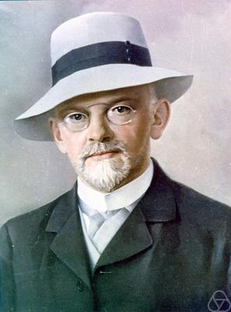
Hilbert’s decision problem (1928)
The vision:
Alg (logical statement) =
0 if the statement is false
1 if the statement is true
David Hilbert
1862 - 1943
Hilbert’s challenge: find such an algorithm
Issues
How to represent logical statements?
How to represent algorithms?
Notes:
18

Slide 19
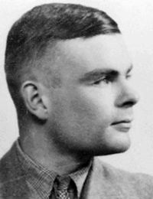
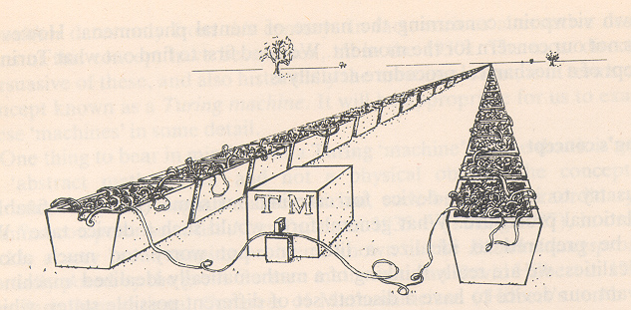
Alan Turing (1930)
Turing’s line of attack on Hilbert’s problem
Create a machine that can calculate all sorts of things, and play with it in order to investigate Hilbert’s challenge (a thought experiment).
Alan Turing
1912 - 1954
The Turing Machine
(drawing by Alan Penrose)
Notes:
19

Slide 20
Turing machine
Task: write a program that computes f (x) = x + 1
...
■
■
■
...
program
...
■
■
■
■
...
input
output
Commands:
L (go left)
R (go right)
■ (write mark)
- (write blank)
# cond act next
1: L 2
2:  1
3:  4
4: R 5
5:  4
Notes:
20

Slide 21
Turing machine
Task: write a program that computes f (x) = x + 1
...
■
■
■
...
Commands:
L (go left)
R (go right)
■ (write mark)
- (write blank)
# cond act next
1: L 2
2:  1
3:  4
4: R 5
5:  4
Notes:
21

Slide 22
Turing machine
Task: write a program that computes f (x) = x + 1
...
■
■
■
...
Commands:
L (go left)
R (go right)
■ (write mark)
- (write blank)
# cond act next
1: L 2
2:  1
3:  4
4: R 5
5:  4
Notes:
22

Slide 23
Turing machine
Task: write a program that computes f (x) = x + 1
...
■
■
■
...
Commands:
L (go left)
R (go right)
■ (write mark)
- (write blank)
# cond act next
1: L 2
2:  1
3:  4
4: R 5
5:  4
Notes:
23

Slide 24
Turing machine
Task: write a program that computes f (x) = x + 1
...
■
■
■
...
Commands:
L (go left)
R (go right)
■ (write mark)
- (write blank)
# cond act next
1: L 2
2:  1
3:  4
4: R 5
5:  4
Notes:
24

Slide 25
Turing machine
Task: write a program that computes f (x) = x + 1
...
■
■
■
...
Commands:
L (go left)
R (go right)
■ (write mark)
- (write blank)
# cond act next
1: L 2
2:  1
3:  4
4: R 5
5:  4
Notes:
25

Slide 26
Turing machine
Task: write a program that computes f (x) = x + 1
...
■
■
■
...
Commands:
L (go left)
R (go right)
■ (write mark)
- (write blank)
# cond act next
1: L 2
2:  1
3:  4
4: R 5
5:  4
Notes:
26

Slide 27
Turing machine
Task: write a program that computes f (x) = x + 1
...
■
■
■
...
Commands:
L (go left)
R (go right)
■ (write mark)
- (write blank)
# cond act next
1: L 2
2:  1
3:  4
4: R 5
5:  4
Notes:
27

Slide 28
Turing machine
Task: write a program that computes f (x) = x + 1
...
■
■
■
...
Commands:
L (go left)
R (go right)
■ (write mark)
- (write blank)
# cond act next
1: L 2
2:  1
3:  4
4: R 5
5:  4
Notes:
28

Slide 29
Turing machine
Task: write a program that computes f (x) = x + 1
...
■
■
■
...
Commands:
L (go left)
R (go right)
■ (write mark)
- (write blank)
# cond act next
1: L 2
2:  1
3:  4
4: R 5
5:  4
Notes:
29

Slide 30
Turing machine
Task: write a program that computes f (x) = x + 1
...
■
■
■
...
Commands:
L (go left)
R (go right)
■ (write mark)
- (write blank)
# cond act next
1: L 2
2:  1
3:  4
4: R 5
5:  4
Notes:
30

Slide 31
Turing machine
Task: write a program that computes f (x) = x + 1
...
■
■
■
...
Commands:
L (go left)
R (go right)
■ (write mark)
- (write blank)
# cond act next
1: L 2
2:  1
3:  4
4: R 5
5:  4
Notes:
31

Slide 32
Turing machine
Task: write a program that computes f (x) = x + 1
...
■
■
■
...
Commands:
L (go left)
R (go right)
■ (write mark)
- (write blank)
# cond act next
1: L 2
2:  1
3:  4
4: R 5
5:  4
Notes:
32

Slide 33
Turing machine
Task: write a program that computes f (x) = x + 1
...
■
■
■
...
Commands:
L (go left)
R (go right)
■ (write mark)
- (write blank)
# cond act next
1: L 2
2:  1
3:  4
4: R 5
5:  4
Notes:
33

Slide 34
Turing machine
Task: write a program that computes f (x) = x + 1
...
■
■
■
...
Commands:
L (go left)
R (go right)
■ (write mark)
- (write blank)
# cond act next
1: L 2
2:  1
3:  4
4: R 5
5:  4
Notes:
34

Slide 35
Turing machine
Task: write a program that computes f (x) = x + 1
...
■
■
■
■
...
Commands:
L (go left)
R (go right)
■ (write mark)
- (write blank)
# cond act next
1: L 2
2:  1
3:  4
4: R 5
5:  4
Notes:
35

Slide 36
Turing machine
Task: write a program that computes f (x) = x + 1
...
■
■
■
■
...
Commands:
L (go left)
R (go right)
■ (write mark)
- (write blank)
# cond act next
1: L 2
2:  1
3:  4
4: R 5
5:  4
Notes:
36

Slide 37
Turing machine
Task: write a program that computes f (x) = x + 1
...
■
■
■
■
...
Commands:
L (go left)
R (go right)
■ (write mark)
- (write blank)
# cond act next
1: L 2
2:  1
3:  4
4: R 5
5:  4
Notes:
37

Slide 38
Turing machine
Task: write a program that computes f (x) = x + 1
...
■
■
■
■
...
Commands:
L (go left)
R (go right)
■ (write mark)
- (write blank)
# cond act next
1: L 2
2:  1
3:  4
4: R 5
5:  4
Notes:
38

Slide 39
Turing machine
Task: write a program that computes f (x) = x + 1
...
■
■
■
■
...
Commands:
L (go left)
R (go right)
■ (write mark)
- (write blank)
# cond act next
1: L 2
2:  1
3:  4
4: R 5
5:  4
Notes:
39

Slide 40
Turing machine
Task: write a program that computes f (x) = x + 1
...
■
■
■
■
...
Commands:
L (go left)
R (go right)
■ (write mark)
- (write blank)
# cond act next
1: L 2
2:  1
3:  4
4: R 5
5:  4
Notes:
40

Slide 41
Turing machine
Task: write a program that computes f (x) = x + 1
...
■
■
■
■
...
Commands:
L (go left)
R (go right)
■ (write mark)
- (write blank)
# cond act next
1: L 2
2:  1
3:  4
4: R 5
5:  4
Notes:
41

Slide 42
Turing machine
Task: write a program that computes f (x) = x + 1
...
■
■
■
■
...
Commands:
L (go left)
R (go right)
■ (write mark)
- (write blank)
# cond act next
1: L 2
2:  1
3:  4
4: R 5
5:  4
Notes:
42

Slide 43
Turing machine
Task: write a program that computes f (x) = x + 1
...
■
■
■
■
...
Commands:
L (go left)
R (go right)
■ (write mark)
- (write blank)
# cond act next
1: L 2
2:  1
3:  4
4: R 5
5:  4
Notes:
43

Slide 44
Turing machine
Task: write a program that computes f (x) = x + 1
...
■
■
■
■
...
Commands:
L (go left)
R (go right)
■ (write mark)
- (write blank)
# cond act next
1: L 2
2:  1
3:  4
4: R 5
5:  4
Notes:
44

Slide 45
Turing machine
Task: write a program that computes f (x) = x + 1
...
■
■
■
■
...
Commands:
L (go left)
R (go right)
■ (write mark)
- (write blank)
# cond act next
1: L 2
2:  1
3:  4
4: R 5
5:  4
Notes:
45

Slide 46
Turing machine
Task: write a program that computes f (x) = x + 1
...
■
■
■
■
...
Commands:
L (go left)
R (go right)
■ (write mark)
- (write blank)
# cond act next
1: L 2
2:  1
3:  4
4: R 5
5:  4
Notes:
46

Slide 47
Turing machine
Task: write a program that computes f (x) = x + 1
...
■
■
■
■
...
Commands:
L (go left)
R (go right)
■ (write mark)
- (write blank)
# cond act next
1: L 2
2:  1
3:  4
4: R 5
5:  4
Notes:
47

Slide 48
Turing machine
Task: write a program that computes f (x) = x + 1
...
■
■
■
■
...
Commands:
L (go left)
R (go right)
■ (write mark)
- (write blank)
# cond act next
1: L 2
2:  1
3:  4
4: R 5
5:  4
Notes:
48

Slide 49
Turing machine
Task: write a program that computes f (x) = x + 1
...
...
...
■
■
■
...
add 1
...
■
...
■
■
■
■
■
■
■
input
output
Commands:
L (go left)
R (go right)
■ (write mark)
- (write blank)
# cond act next
1: L 2
2:  1
3:  4
4: R 5
5:  4
Lemma: the function f (x) = x + 1 is computable
Proof: show that for any given x, there is a Turing machine that outputs x + 1.
Notes:
49

Slide 50
Turing machine
Task: write a program that computes f (x,y) = x + y
...
...
...
■
■
■
■
■
...
add
...
■
■
...
■
■
■
■
■
■
■
input
output
Commands:
L (go left)
R (go right)
■ (write mark)
- (write blank)
# cond act next
A sequence of commands that causes the machine to compute x + y
Lemma: The function f (x,y) = x + y is computable
Proof: show that for any given x and y, there is a Turing machine that outputs x + y
Notes:
50

Slide 51
Computable functions
x + 1
x + y
Notes:
51

Slide 52
Computable functions
x + 1
x + y
x * y
x^{y}
x – y
x / y
5x³ – 16x² + 11x – 7
...
Turing showed that all these functions (and many more) are computable
Notes:
52

Slide 53
Revisiting Hilbert’s decision problem
0 if the statement is false
1 if the statement is true
Hilbert’s challenge:
find the algorithm
Alg (logical statement) =
Turing’s line of attack
Represent algorithms as TM programs
Insight: any TM program can be represented as a number, and treated as input:
1: L 2
2:  1
3:  4
4: R 5
5:  4
encode as one (possibly long) number
2
1
4
5
4
We can write programs that read and process other programs
Programs = data
Theoretical implications: Turing needed this duality for his analysis
Practical implications: assemblers, compilers, operating systems ...
Notes:
53

Slide 54
Computable functions
x + 1
x + y
x – y
x * y
x^{y}
x / y
5x³ – 16x² + 11x – 7
...
Turing showed that all these functions are computable
Can we compute anything we want?
Notes:
54

Slide 55
Computable functions
x + 1
x + y
x – y
x * y
x^{y}
x / y
5x³ – 16x² + 11x – 7
...
Turing showed that all these functions are computable
Can we compute anything we want?
Turing’s historical result:
No.
Notes:
55

Slide 56
Computable functions
x + 1
x + y
x – y
x * y
x^{y}
x / y
5x³ – 16x² + 11x – 7
...
Turing showed that all these functions are computable
Can we compute anything we want?
Turing’s historical result:
There are algorithms that cannot be implemented as Turing machines
Hilbert’s decision problem is one of them.
(the proof is not complicated, but requires a semester-long course in mathematical logic).
No.
Notes:
56

Slide 57
Turing’s tantalizing insight (among many others)
Turing’s result
There are (many) algorithms that cannot be mechanized
Turing-Church conjecture
All computers are logically equivalent. For every program written on any computer, there is a Turing machine that does the same thing
Implication
All computers are inherently limited.
Notes:
57

Slide 58
Turing’s Contributions (1936)
Direct contribution:
Computers can do many fantastic things
But, computers are inherently limited
Turing’s proof technique was brilliant, a landmark in mathematics and philosophy
Indirect contribution (1936, eight years before Von Neumann):
Provided exact definitions and formal articulation of:
hardware / software
input / output
instruction set
command / conditional command
programs / programming
program execution
...
programs = data
stored program concept
code analysis / formal verification
virtual machines
operating system
artificial intelligence
...
Notes:
58

Slide 59

Turing’s Contributions (1936)
...
■
■
■
...
program
...
■
■
■
■
...
Action:
L (go left)
R (go right)
■ (write mark)
- (write blank)
# cond act next
1: L 2
2:  1
3:  4
4: R 5
5:  4
CS
Also gave formal definitions of:
Hardware, instruction set, statement, conditional statement, software, programs, input, output, execution, ...
Notes:
59

Slide 60
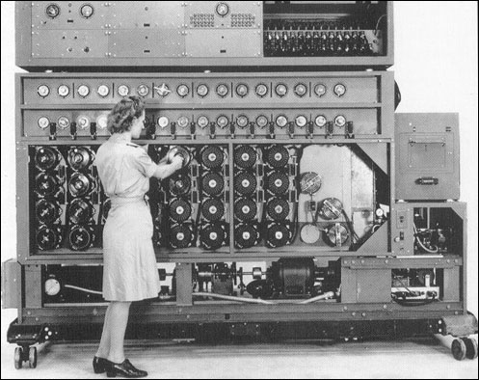
Turing’s Contributions (1936)
Turing also built a computer that cracked the code that the Nazis used in World War II
Notes:
60

Slide 61
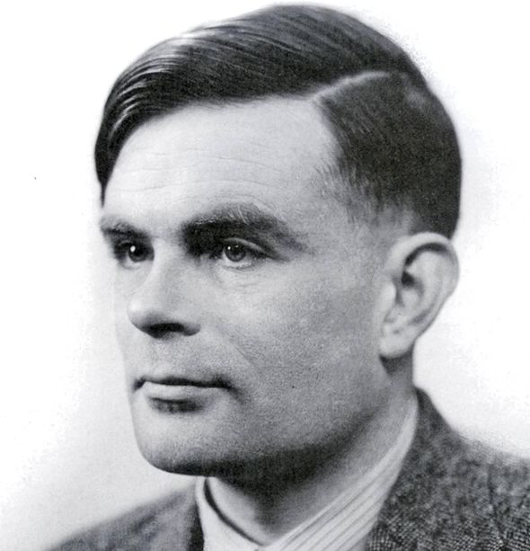
Turing’s legacy
Often described as “the father of computer science” and “the man who saved the west”
Committed suicide at 42,
after being accused and tried for a homosexual act
Notes:
61

Slide 62
Lecture plan
History of computer science
Before Alan Turing
After Alan Turing
High-level programming
Languages
Compilation

Slide 63
Back to Vic...
We can write Vic programs that compute:
We can also write Vic programs that:
x + y
x - y
x * y
x / y
x^{y}
5 * 17³ - 16 * (-9)¹² + 11 * 27⁵
sqrt(X), log(x), sin(x), exp(x), ...
etc.
sum up a series
count a series
compute average & variance
compute max(x,y)
compute the max of a series
sort a series
merge two series
find an item in a series
etc.
Observations:
The Vic computer is Turing-complete
Therefore, it is as effective as any computer out there
But, writing programs for this computer is a pain.

Slide 64
Low-level machine language
Task: sum up a series of numbers that ends with a zero
Assembly language
Executable code
load zero
store sum
read
store x
BEGINWHILE
gotoz ENDWHILE
load x
add sum
store sum
read
store x
goto BEGINWHILE
ENDWHILE:
load sum
write
stop
00
01
02
03
05
06
07
08
09
10
11
12
13
398
490
800
491
610
190
490
800
491
504
390
900
000
Assembler
Can we come up with a more friendly language?

Slide 65
High-Level language
Task: sum up a series of numbers that ends with a zero
High-level language
Assembly language
Executable code
sum = 0
read x
while !(x==0) {
sum = sum + x
read x
}
write sum
load zero
store sum
read
store x
BEGINWHILE
gotoz ENDWHILE
load x
add sum
store sum
read
store x
goto BEGINWHILE
ENDWHILE:
load sum
write
stop
00
01
02
03
05
06
07
08
09
10
11
12
13
398
490
800
491
610
190
490
800
491
504
390
900
000
Assembler
High-level programs...
if, while, for,...
Expressed in a language which is closer to how humans think
Machine-independent
Require a compiler.

Slide 66
High-Level language
Task: sum up a series of numbers that ends with a zero
High-level language
Assembly language
Executable code
sum = 0
read x
while !(x==0) {
sum = sum + x
read x
}
write sum
load zero
store sum
read
store x
BEGINWHILE
gotoz ENDWHILE
load x
add sum
store sum
read
store x
goto BEGINWHILE
ENDWHILE:
load sum
write
stop
00
01
02
03
05
06
07
08
09
10
11
12
13
398
490
800
491
610
190
490
800
491
504
390
900
000
compiler
Assembler
High-level programs...
if, while, for,...
Expressed in a language which is closer to how humans think
Machine-independent
Require a compiler.

Slide 67
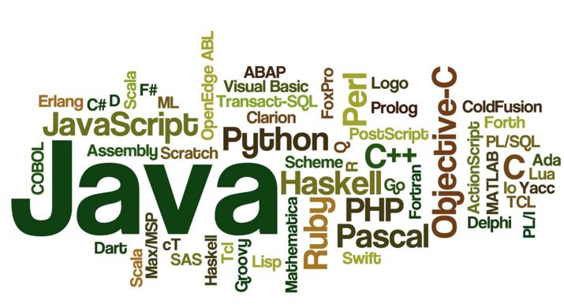
High-Level languages
There are hundreds of programming languages
Most software (2023) is writte in Java, Javascript, Python, C, C++

Slide 68
High-Level languages
algorithm
The same HL program can be compiled for different computer platforms
Implications for
users
software companies
hardware companies
competition, innovation, ...
Users don’t have to see the HL source code; They get only the executable code. This way, software companies can protect their intellectual property. Important exception: Open source
Computer scientists can invent all sorts of HL languages, designed for different purposes; As long as we can translate the HL code to machine language, the language can be as abstract as we want
The notion of a HL language creates a decoupling between software and hardware. This is one of the most important ideas in CS.
High Level Language
source code
executable code
Compiler
Runtime system

Slide 69
Lecture plan
History of computer science
Before Alan Turing
After Alan Turing
High-level programming
Languages
Compilation

Slide 70
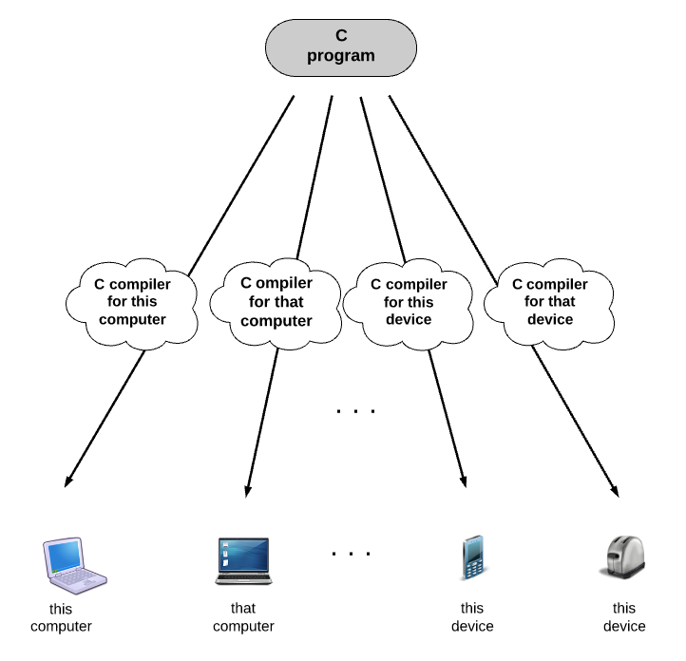
Classical compilation model

Slide 71
Classical compilation model
Each target computer requires a separate compilation
Main advantage: efficient code
Main disadvantage: not portable

Slide 72
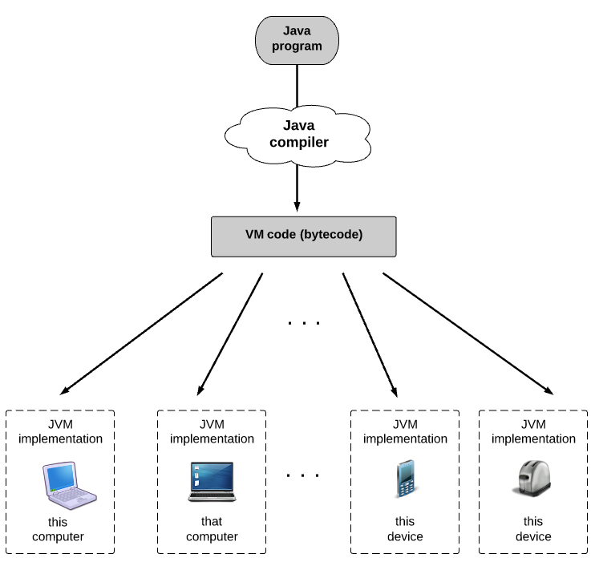
2-tier compilation
Prog.java
Java compiler:
A program hat translates Java code into an intermediate VM code
(CPU and OS agnostic)
% javac Prog.java
Prog.class

Slide 73
2-tier compilation
Prog.java
Java compiler:
A program hat translates Java code into an intermediate VM code
(CPU and OS agnostic)
% javac Prog.java
Prog.class
% java Prog
JVM implementation:
A program that translates the VM code into machine language (CPU and OS specific)
Assumption:
each device out there is equipped with a JVM implementation
machine language code that executes on the target computer

Slide 74
2-tier compilation
Main advantage: Write/compile the Java program once, run it everywhere
Main disadvantage: The resulting target code is less efficient (compared to C/C++).

Slide 75
2-tier compilation
Java source code (FileName.java)
compiled bytecode (FileName.class)
executable code
// prints the numbers 0 to 5
public class PrintSomeNumbers {
public static void main(String[] args) {
int i = 0;
while (i < 6) {
// print the current value of i
System.out.println(i);
i = i + 1;
}
System.out.println(“Done”);
}
}
Compiled from "PrintSomeNumbers.java"
public class PrintSomeNumbers
extends java.lang.Object{
public PrintSomeNumbers();
Code:
0: aload_0
1: invokespecial #1;
4: return
public static void main(java.lang.String[]);
Code:
0: iconst_0
1: istore_1
2: iload_1
3: bipush 6
5: if_icmpge 22
8: getstatic #2;
11: iload_1
12: invokevirtual #3;
15: iload_1
16: iconst_1
17: iadd
18: istore_1
19: goto 2
22: getstatic #2;
25: ldc #4;
27: invokevirtual #5;
30: return
}
10110010110100101100110001001100
10101010110101010101010010111111
01010100111110101010111010101011
11111110010101001010101001010101
01000101011010101001010101010101
00101001010010100101011010101010
11010001111001011010100110101001
00101100100101001000010011110010
00100100101010111001010110101010
10110010110100101100110001001100
10101010110101010101010010111111
01010100111110101010111010101011
11111110010101001010101001010101
01000101011010101001010101010101
00101001010010100101011010101010
00101100100101001000010011110010
00100100101010111001010110101010
10110010110100101100110001001100
10101010110101010101010010111111
01010100111110101010111010101011
11111110010101001010101001010101
01000101011010101001010101010101
00101001010010100101011010101010
00101100100101001000010011110010
00100100101010111001010110101010
10110010110100101100110001001100
10101010110101010101010010111111
...
javac
Java
The bytecode of fileName.java can viewed by the command:
javap –c fileName
The source code is compiled by the developer
The user’s machine gets only the compiled bytecode
When the user’s machine applies “java”, the JVM implementation on the user’s device translates the bytecode into the machine language of the host CPU, and executes it.

Slide 76
Introduction to Computer Science
Shimon Schocken
IDC Herzliya
Lecture 8-1
Computer Fundamentals
Part II
Notes:
76

